Slide 1

Crime Frequencies & Housing Analysis in Montgomery County Data 205 - Capstone Final Project
Karim MardamBey
CRN 33155
5/11/2026
Prof. Lori Perine

Slide 2
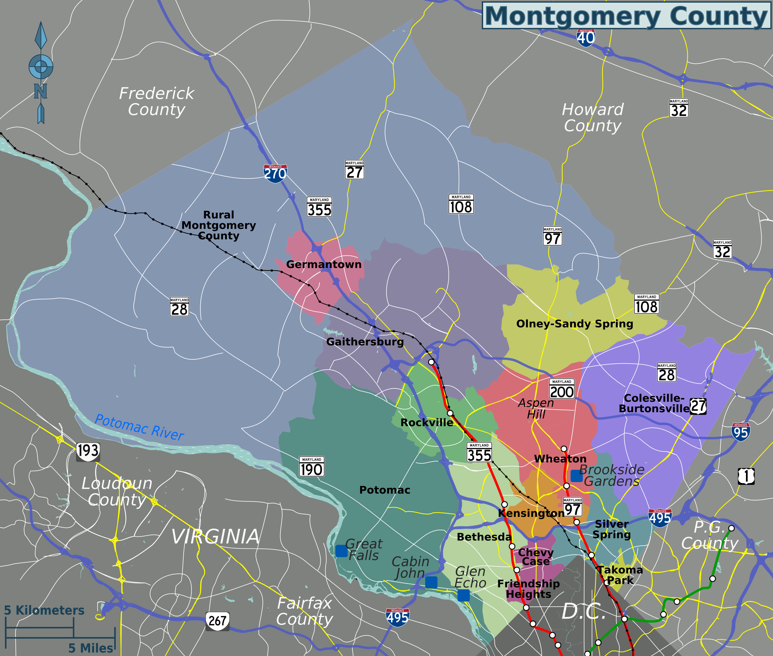
Project Goals & Purpose
Main Goal: Analyze crime frequencies across Montgomery County
Do Urban areas in Montgomery County experience higher crime rates?
(Correlation between Population Density and Crime Rates)
What crime classifications are predominant in Montgomery County?
(Difference in Violent vs. Non-Violent crimes)
Does the residential infrastructure influence the frequency of crime rates?
(Community Safety and Socio-Economic assessment)

Slide 3

Data Sets / Ingestion and Cleaning A.
Crime Rates Dataset:
https://data.montgomerycountymd.gov/Public-Safety/Crime-Incident-Map/df95-9nn9
Crimes Rates Dataset: 400,000+ crime incident records
Housing Licensing and Registration:
https://data.montgomerycountymd.gov/Consumer-Housing/Housing-Licensing-and-Registration/et5s-xste/about_data
Housing Licensing and Registration Dataset: ~ 30,000 property records

Slide 4

Data Sets / Ingestion and Cleaning B.
Dataset cleaning consisted of:
Removing invalid or redundant ZIP code entries.
Renaming municipalities (original dataset had misspelled city names and repeated names).
Transformed dispatch dates and times to accurately plot time series analysis and other explorations.
Aggregated the dates to match with seasonal months (Spring, Summer, Fall, Winter).
Separated Longitude and Latitude from the addresses in the Housing and Licensing dataset.
Libraries used:
dplyr
tidyr
leaflet
ggplot2
ggfortify
lubridate

Slide 5
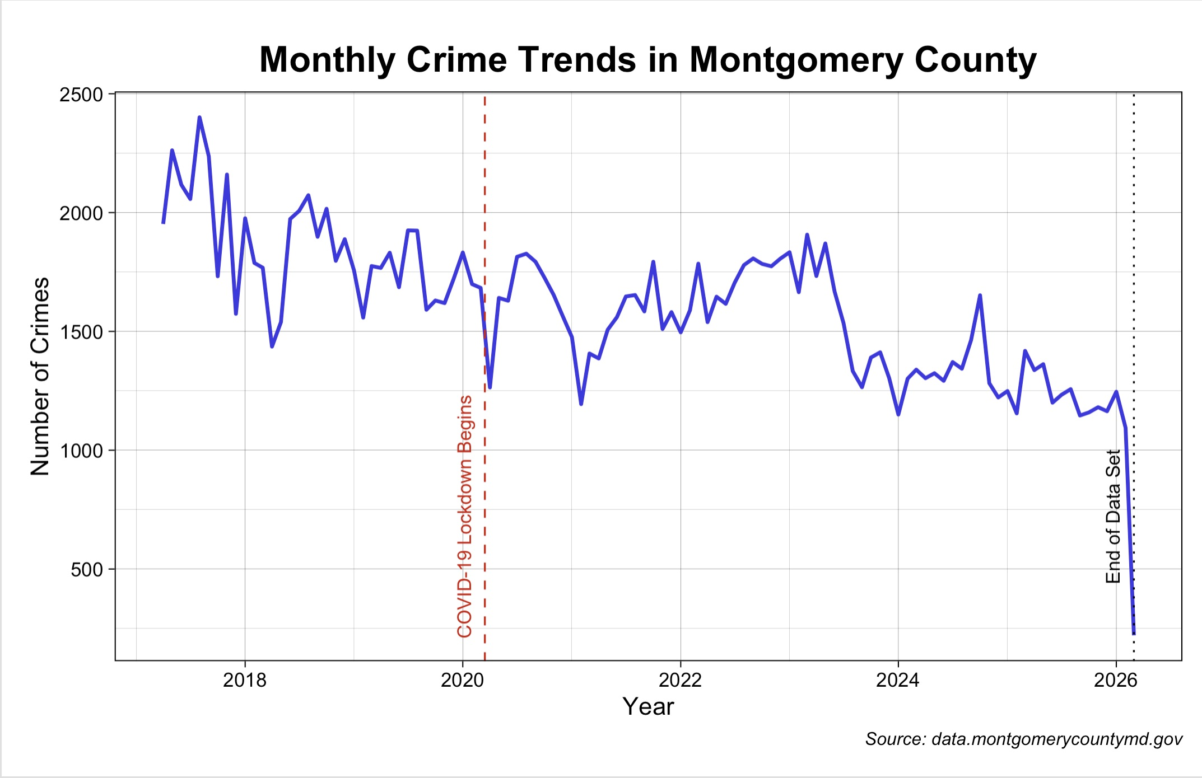
Time Series Analysis
Monthly Crime Trends:
Monthly crime trends were recorded using 2500 occurrences per month
(max).
Crime rates saw a sharp drop after COVID-19 lockdowns.
Overall, we’ve seen a long-term downward trend in crime rates in
Montgomery County.
* Major drop in crimes is the end of the data set (last recorded date).

Slide 6

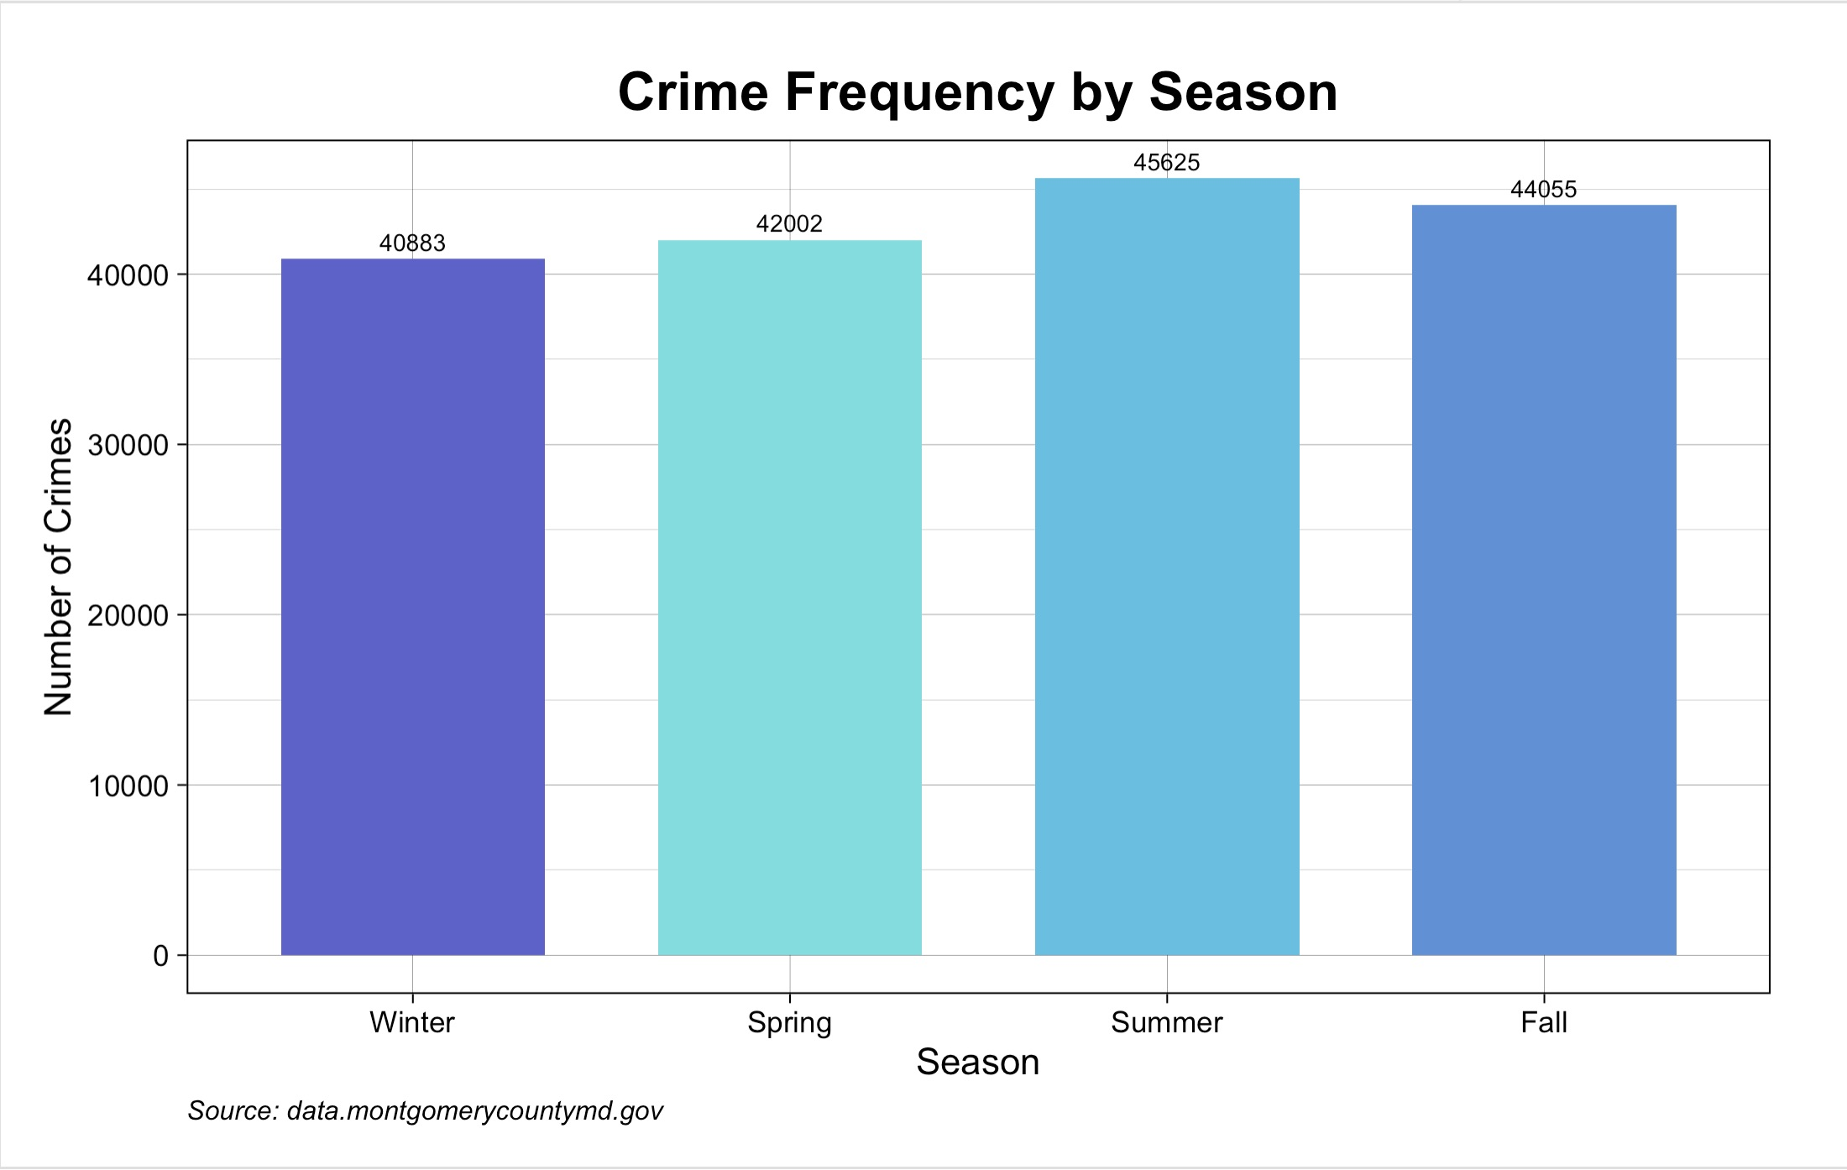
Seasonal Frequency
Seasonal Crime Trends:
Variation in Seasonal Crime Rates
Crime rates increase when warmer weather is more prevalent.
Summer and Fall generally had the highest crime rates (45,625, 44,055) and then dip off into the Winter (40,883).

Slide 7
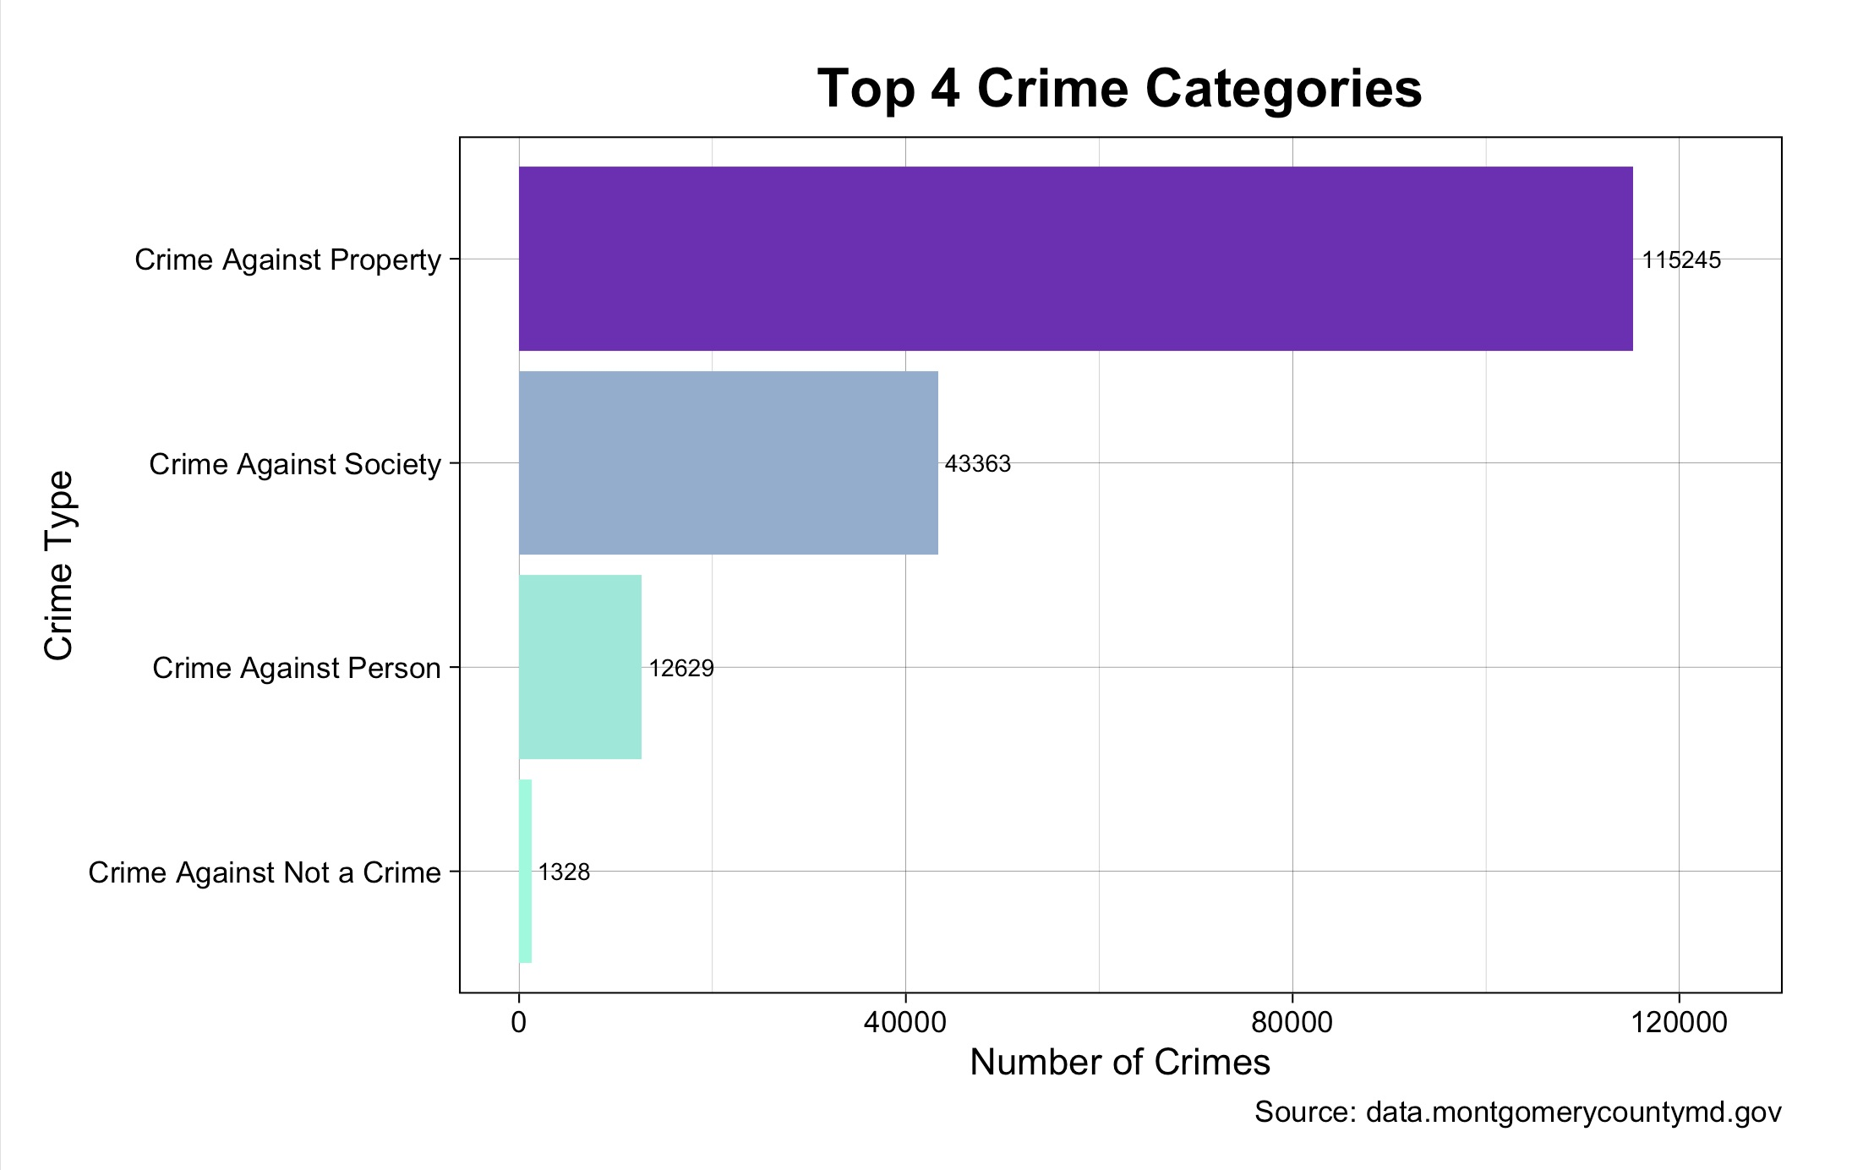

Crime Classification Comparison
Violent vs. Non-Violent Crimes:
Crimes Against Property takes account for ~ 66.8% of the crimes in MoCo reported.
Crimes Against Person accounted for ~ 7.3% of the overall
Crimes in MoCo.
Non-Violent crimes are the most frequent occurring in
Montgomery County.

Slide 8
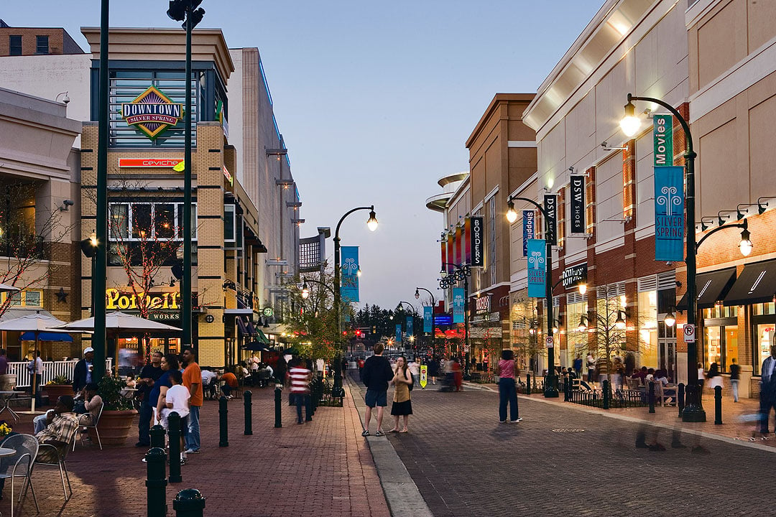
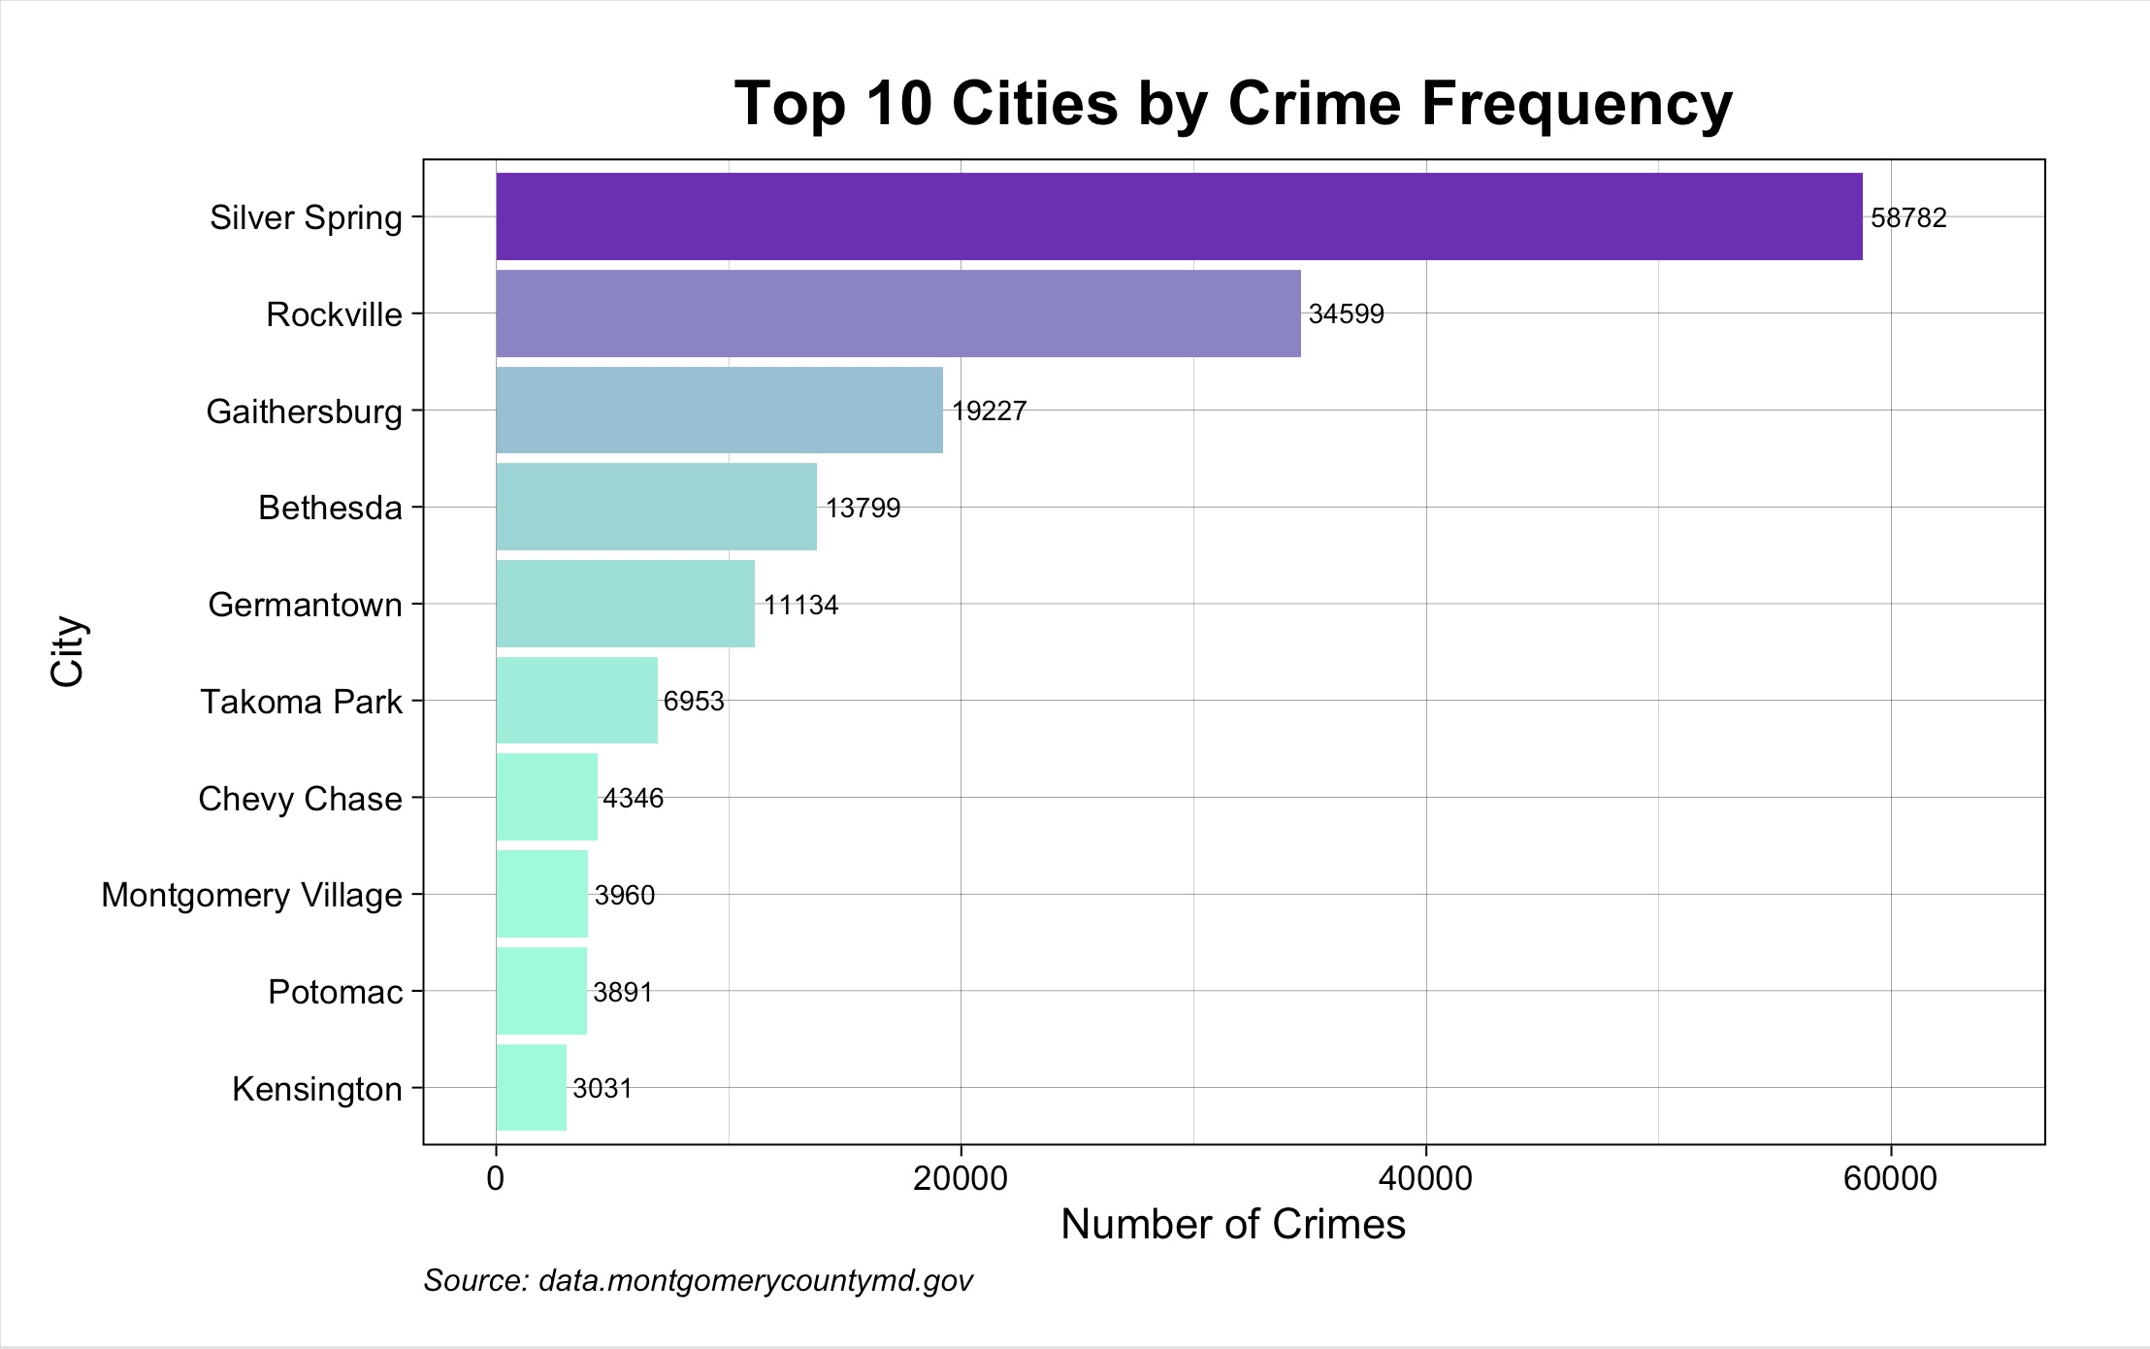
City Crime Frequencies
Crime Frequency by Municipality:
Silver Spring accounted for the highest total crimes in Montgomery County at ~ 34.1% .
Urban developed areas of MoCo experience higher rates of crime.
Crime rates decrease substantially outside of highly populated areas.
Population density likely correlates to the increase in crime rates.

Slide 9
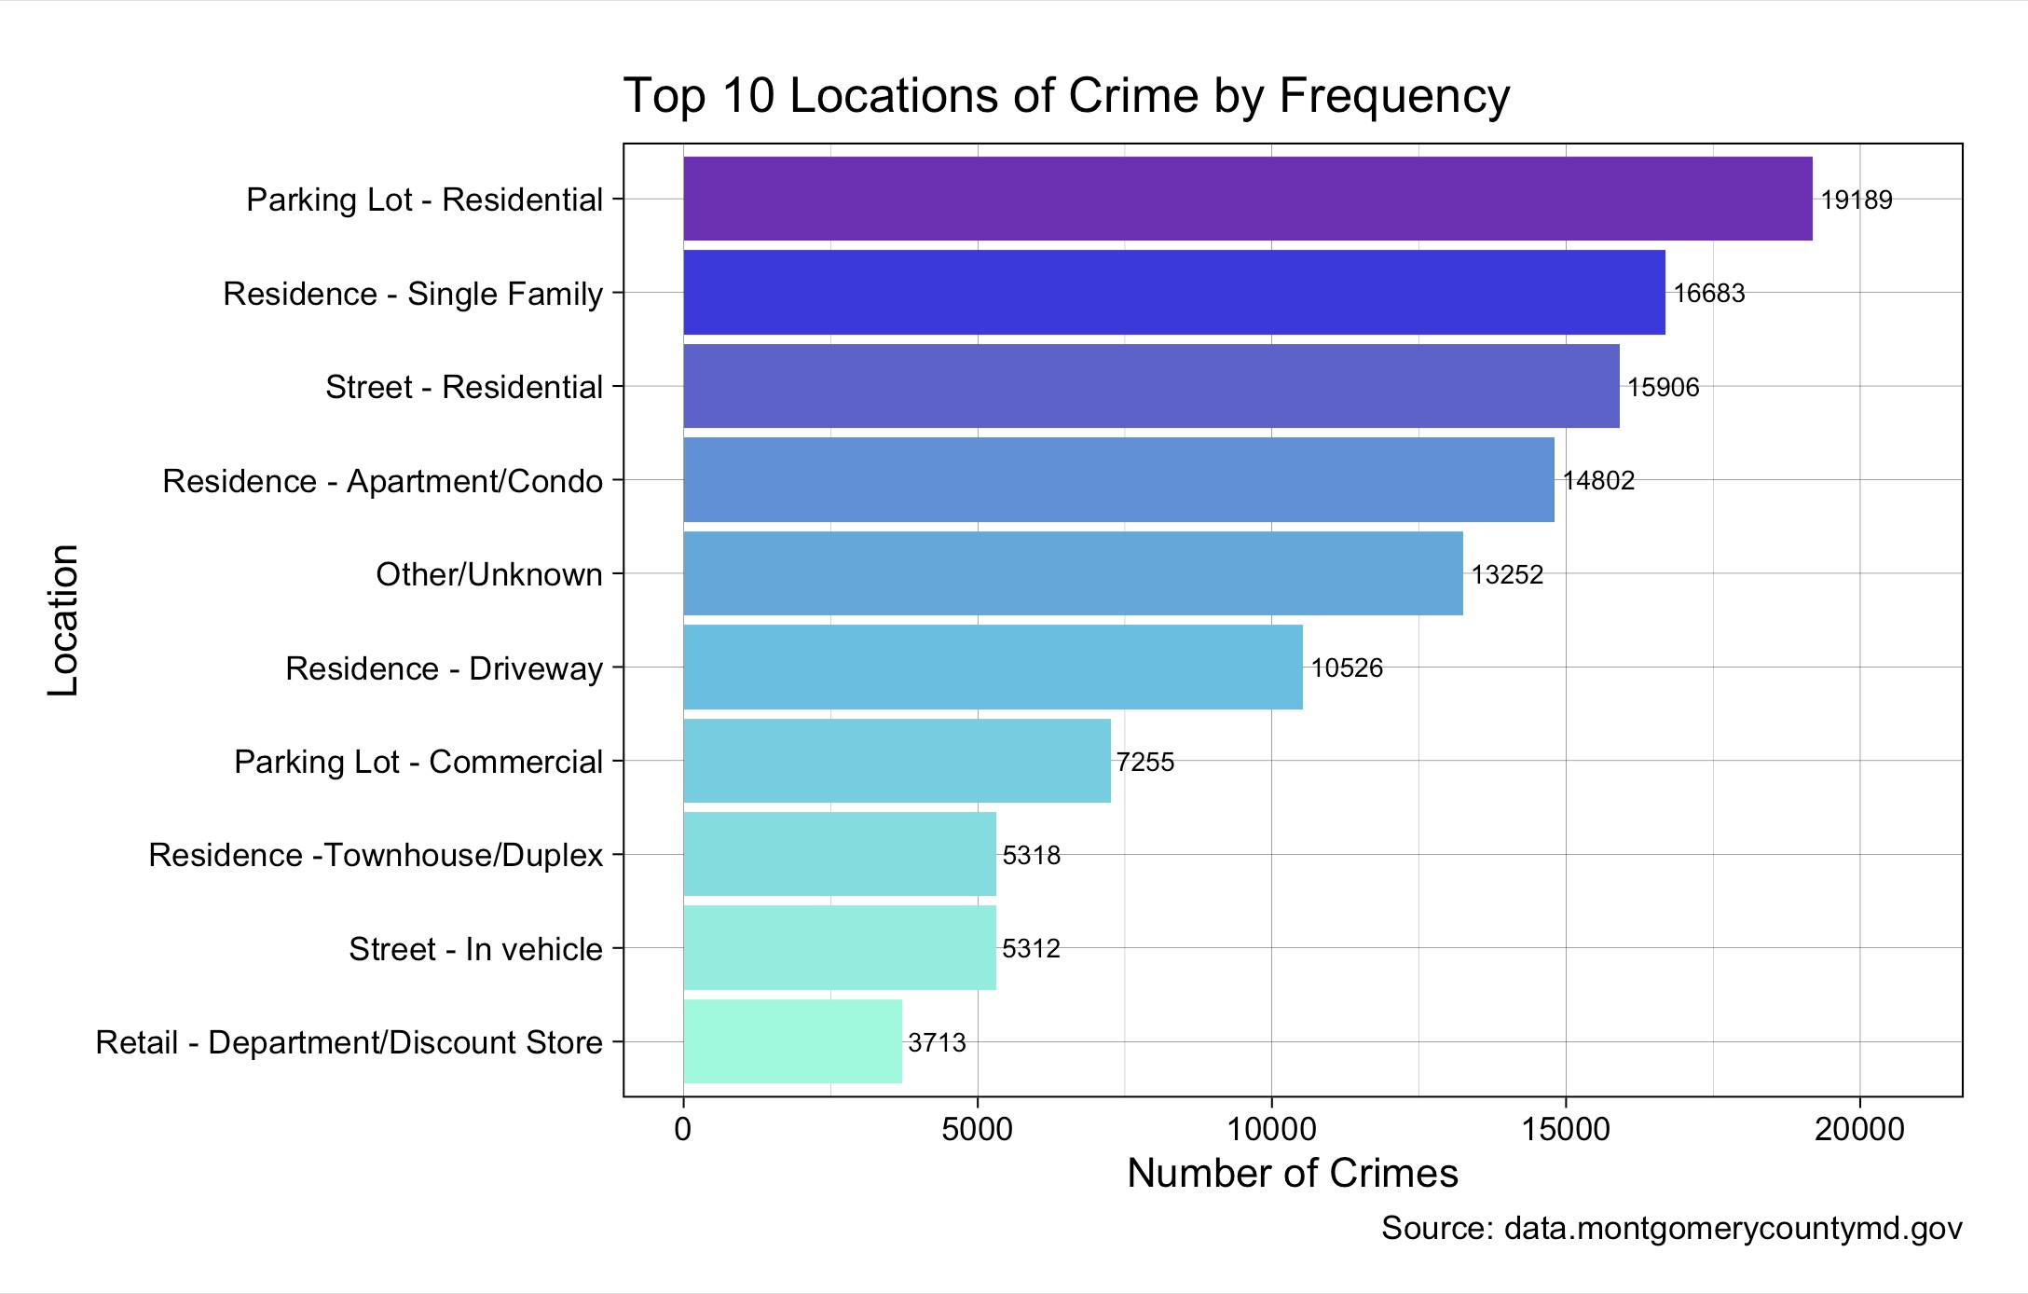
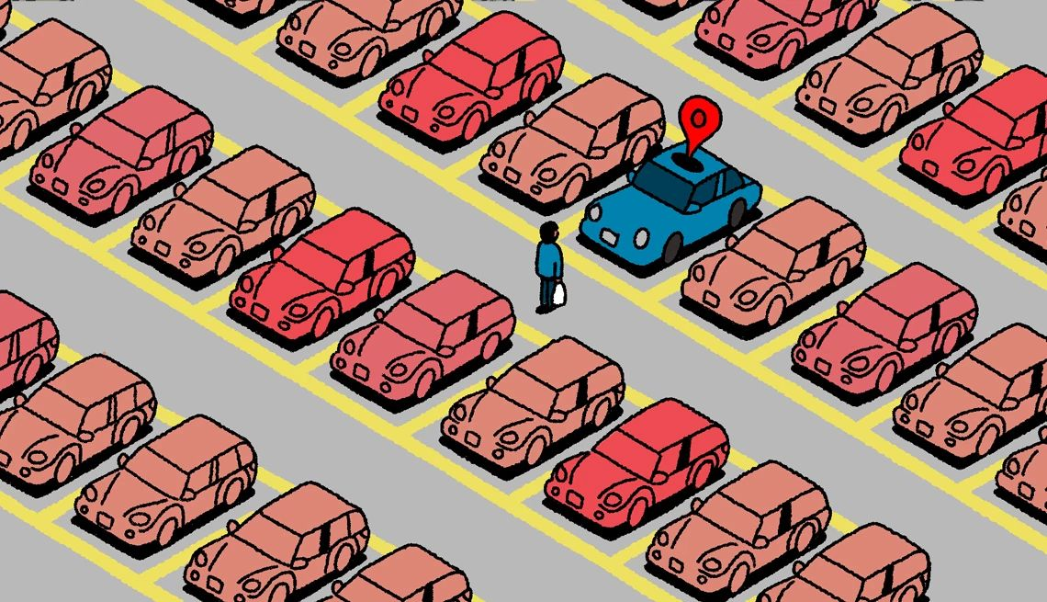
Common Crime Locations
Crime Location Analysis:
Residential areas saw the highest rates of reported crimes.
Crimes cluster the most in high traffic residential areas.
Crimes Against Property can be correlated with crime
frequency based on location.

Slide 10
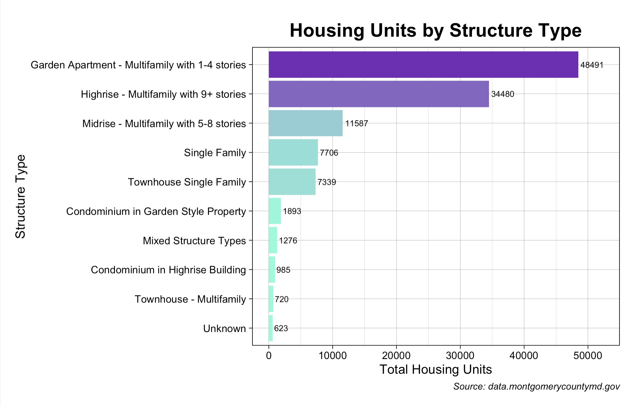
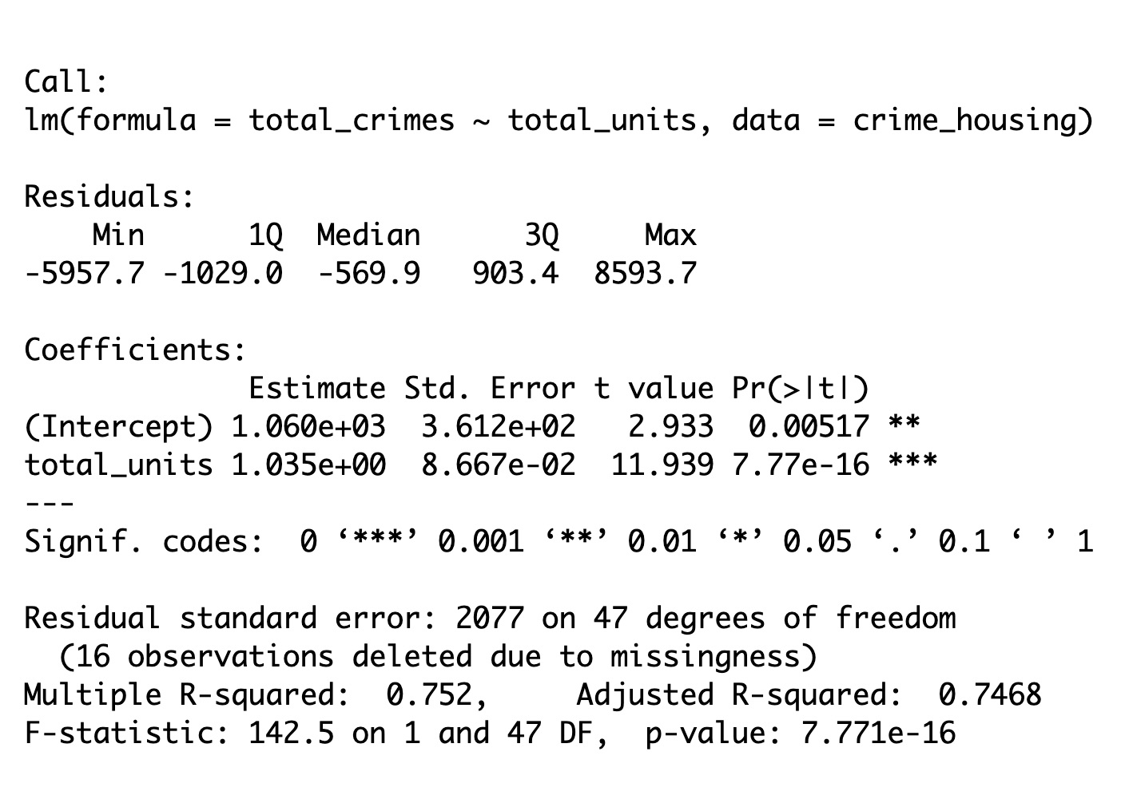
Variety of Housing Structures in MoCo
Housing Units Summary:
Multifamily housing represents the majority of the housing category in
Montgomery County.
Apartments and Multi Family complexes were most common in highly
populated areas of MoCo.
Residential infrastructure varies across all the municipalities.
Linear Regression output showed that 75.2% of crime totals can be
correlated with the housing unit totals.

Slide 11
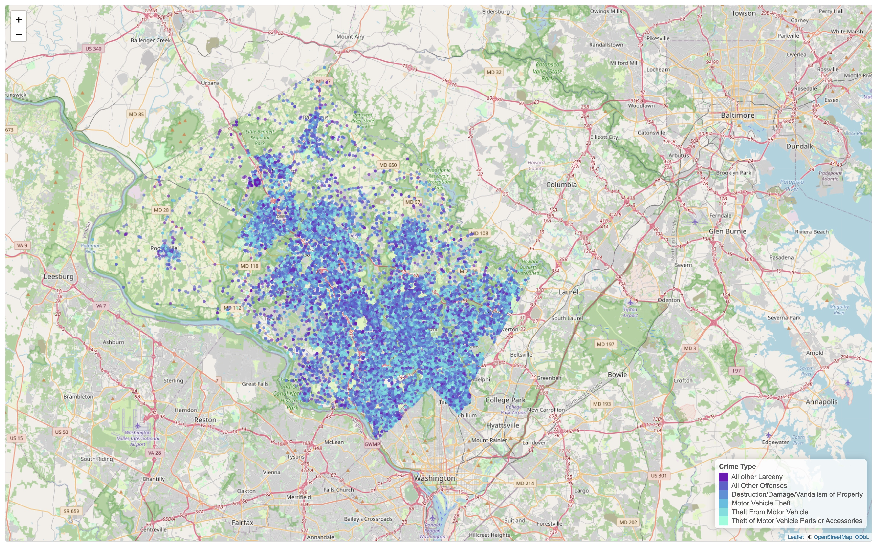
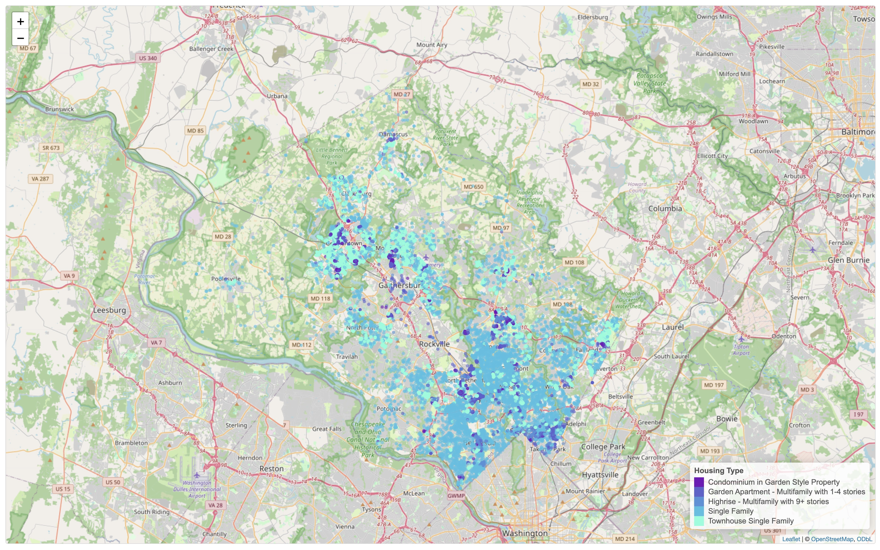
GIS Heat Maps
1st GIS Heat Map: 6 Most Common Crimes in Montgomery County
Crimes Include:
Larceny (Crime against Possession), Destruction/Damage/Vandalism to Property, Motor Vehicle Theft, Theft of Motor Vehicle Parts or Accessories
In correlation to the 2nd GIS Map, we can see that a majority of the crimes cluster around urban residential development.
2nd GIS Heat Map: Locations of Residential Properties
Locations Include:
Condominium in Garden Style Property, Garden Apartment (Multifamily 1-4 stories), Highrise (Multifamily with 9+ stories), Single Family, Townhouse Single Family
Urban development can be seen to cluster in the central and southern parts of
Montgomery County.

Slide 12
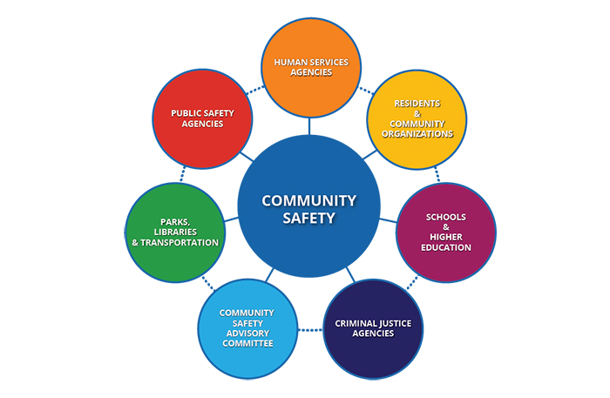
Key Findings and Recommendations
Key Findings:
Crime patterns deviated depending on seasonal and geographic conditions.
Urbanized areas of Montgomery County see higher rates of crime.
Housing density has a correlation with the higher crime frequency.
Recommendations:
Focus community safety resources on densely urbanized areas of Montgomery County.
For future analysis it would have been good to look at socio-economic relationships between housing and crimes.

Slide 13
Acknowledgements
Thank you to:
Prof. Saidi
Prof. Alraee
Prof. Perine

Slide 14
Thank You! and Questions?

